Slide 1
Not so lam(e)da
Kyma Hackathon - 18

Slide 2
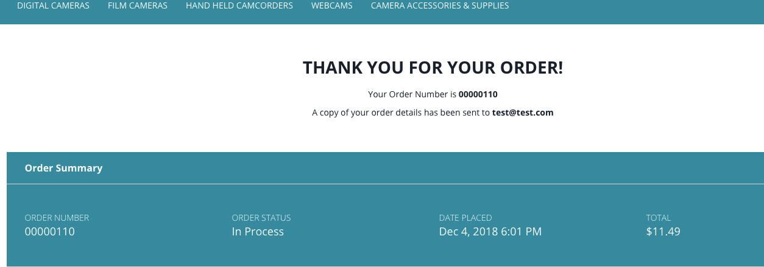
What did we do???
We noticed that you needed help with your missing feature……

Slide 3
Order Summary Emailer
Lambda 2
Sends an order summary to the user
Sends helpful user video guides
Prompts user to look at related stuff
Lambda K
Persists Product Names

Slide 4
Lambda 2 Features
For Each Order
Get the list of Products that belong the order
Get the Delivery Information
Get Relevant Product Suggestions (Frequently Bought together products)
Provide Video Guides to help the user

Slide 5
Technologies/Tools Used

